Slide 1
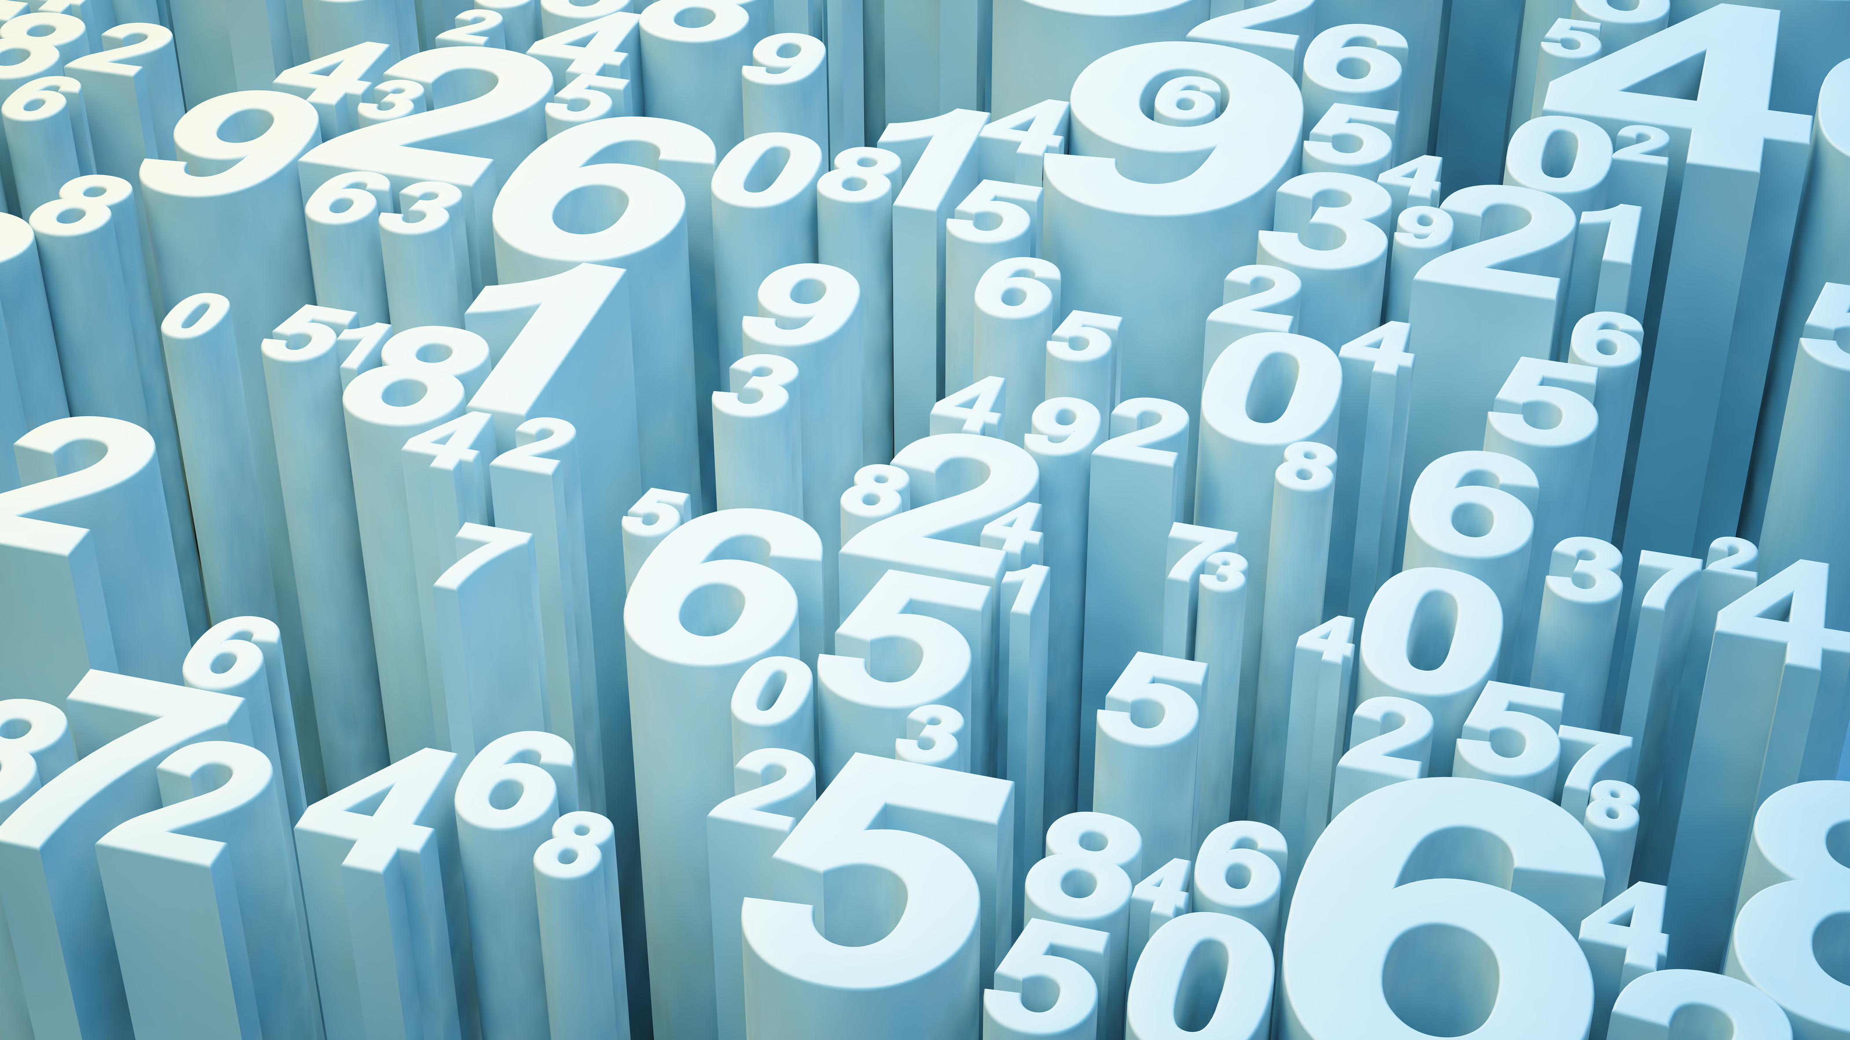
PID Tuning with Neural Networks PIDNN

Slide 2
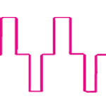
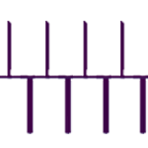
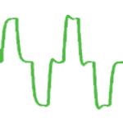
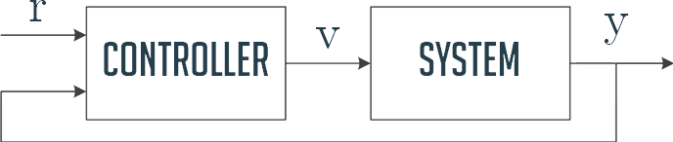
Classic Control-Feedback Problem
Controller takes target value r(t) and feedback y(t) and
produces system input v(t).
System generates new output y(t), which is used as a feedback.

Slide 3
Application
Industrial plants often require controllers for control tasks such as temperature, pressure, or speed regulation.
Proportional-Integral-Derivative (PID) controller is one of the most widely used control algorithms.
The great diffusion of the PID controller is due to its low cost and also is due to the possibility of utilization without the exact knowledge of the industrial process to be controlled.

Slide 4
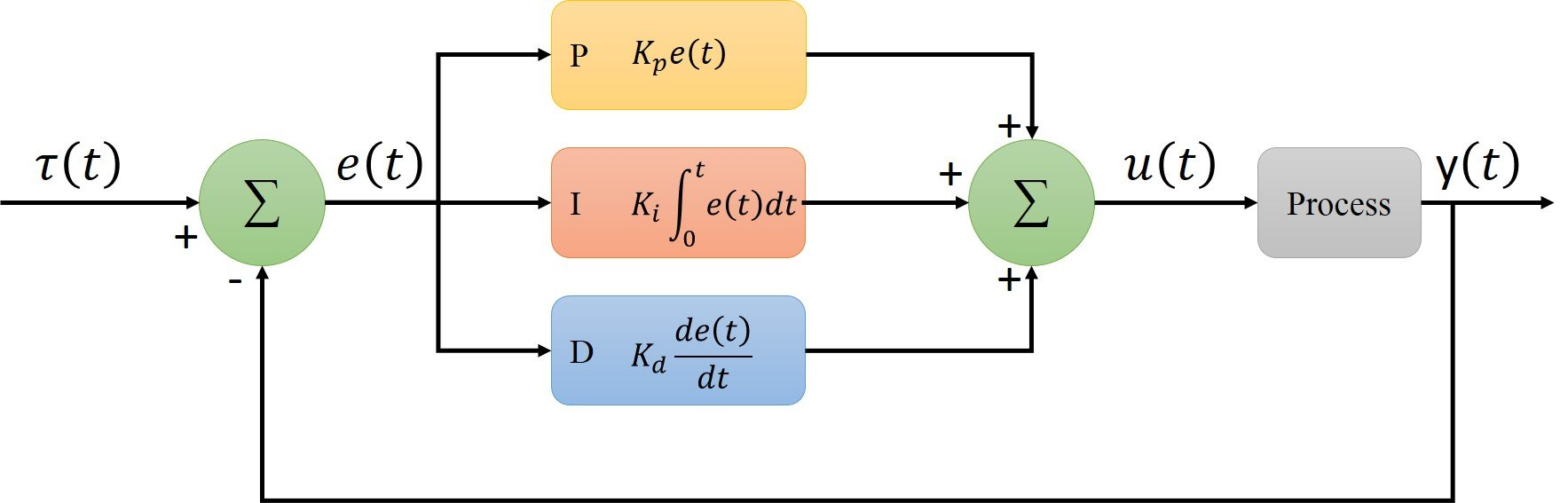
The PID Controller
PID controller combines three control actions: proportional, integral, and derivative.
Proportional action responds to the present error.
Integral action accumulates past errors to eliminate steady-state errors.
Derivative action anticipates future error trends.
PID controllers offer a simple implementation and design for control systems.

Slide 5
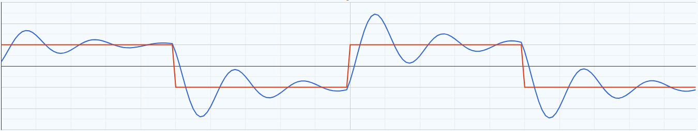
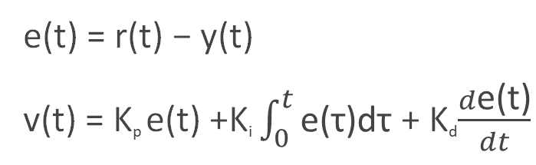
PID controller
e(t) = r(t) − y(t)
v(t) = K_{p} e(t) +K_{i} $\int_{0}^{t}{\text{e}\text{(}\text{τ}\text{)}\text{dτ}}$ + K_{d}$\frac{d\text{e}\text{(}\text{t}\text{)}}{dt}$

Slide 6
PID Math
The PID controller uses a combination of three terms, namely proportional (P), integral (I), and derivative (D), to compute the control output. The mathematical equation for a PID controller can be represented as follows:
Control Output = Kp * Error + Ki * Integral of Error + Kd * Derivative of Error
Here's a brief explanation of each term and its mathematical representation:
Proportional (P) Term:
The proportional term is directly proportional to the current error.
It contributes to the control output in proportion to the magnitude of the error.
Mathematically, the proportional term is given by: Kp * Error
Integral (I) Term:
The integral term takes into account the accumulated error over time.
It helps to eliminate steady-state error and corrects for long-term discrepancies.
Mathematically, the integral term is given by: Ki * ∫(Error dt), where ∫ represents integration.

Slide 7
PID Math
Derivative (D) Term:
The derivative term considers the rate of change of the error.
It helps to dampen rapid changes in the error and improves the system's response.
Mathematically, the derivative term is given by: Kd * d(Error)/dt, where d(Error)/dt represents the derivative of the error with respect to time.
In the equation, Kp, Ki, and Kd are the respective proportional, integral, and derivative gains that determine the controller's response to each term. These gains are typically adjusted through tuning to achieve the desired control behavior.
By combining the proportional, integral, and derivative terms, the PID controller can effectively regulate a system and maintain it at the desired setpoint by continuously adjusting the control output based on the error and its characteristics over time.

Slide 8
Implementation of Pid controller
Set the proportional (Kp), integral (Ki), and derivative (Kd) gains.
Initialize variables: integral term, previous error, and control output.
Calculate the error by subtracting the setpoint from the measured value.
Compute the proportional, integral, and derivative terms.
Sum the terms to obtain the control output.
Apply the control output to the system.
Repeat steps 3-6 in a continuous loop.
Tune the gains based on system performance.
Consider advanced techniques like anti-windup and adaptive tuning for more complex scenarios.

Slide 9
K_{p}, K_{i}, K_{d}
Kp (Proportional Gain):
Determines the proportional response of the controller.
Adjusts the control output in proportion to the error between the desired setpoint and the actual process variable.
A higher Kp value leads to a stronger response but can also result in overshooting and oscillations.
A lower Kp value can make the controller more stable but slower to reach the setpoint.
Ki (Integral Gain):
Controls the integral response of the controller.
Accumulates the error over time and adjusts the control output based on the integral of the error.
Helps to eliminate steady-state errors and corrects for any long-term biases.
Increasing Ki amplifies the response to steady-state errors, but too high a value can introduce instability and overshoot

Slide 10
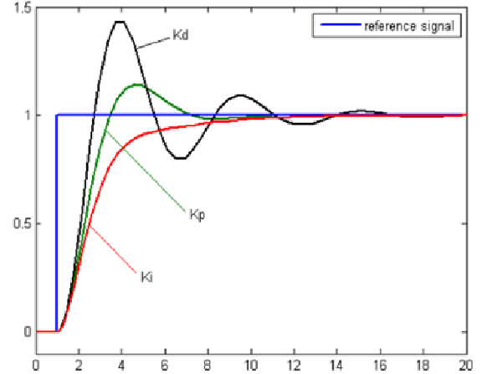
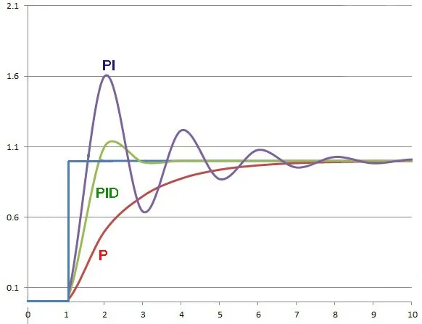
Kd (Derivative Gain):
Influences the derivative response of the controller.
Accounts for the rate of change of the error.
Produces a control output based on the rate at which the error is changing.
Helps to dampen oscillations and improve stability.
Higher values of Kd result in faster response to changes in error, but excessive values can lead to instability and noise amplification.

Slide 11
PID Tuning
PID tuning is the process of adjusting the proportional (K_{p}), integral (K_{i}), and derivative (K_{d}) gains of a PID controller to optimize its performance for a specific control system. The goal of PID tuning is to achieve desired control behavior, such as fast response, stability, and minimal overshoot or oscillation.

Slide 12
Manual Tuning
Set the integral and derivative gains to zero.
Increase the proportional gain (Kp) until the system starts to exhibit oscillations.
Once oscillations occur, reduce the proportional gain slightly to stabilize the system.
If necessary, adjust the integral gain (Ki) to eliminate any steady-state error.
If needed, adjust the derivative gain (Kd) to improve system response and reduce overshoot.

Slide 13
Ziegler-Nichols method
If manual tuning does not yield satisfactory results, you can use the Ziegler-Nichols method as a starting point. This method involves the following steps:
Set all gains to zero.
Gradually increase the proportional gain (Kp) until the system exhibits sustained oscillations.
Note the critical gain value (Ku) and the corresponding period of oscillation (Tu).
Calculate the PID gains using the following formulas:
Kp = 0.6 * Ku
Ki = 1.2 * Ku / Tu
Kd = 0.075 * Ku * Tu

Slide 14
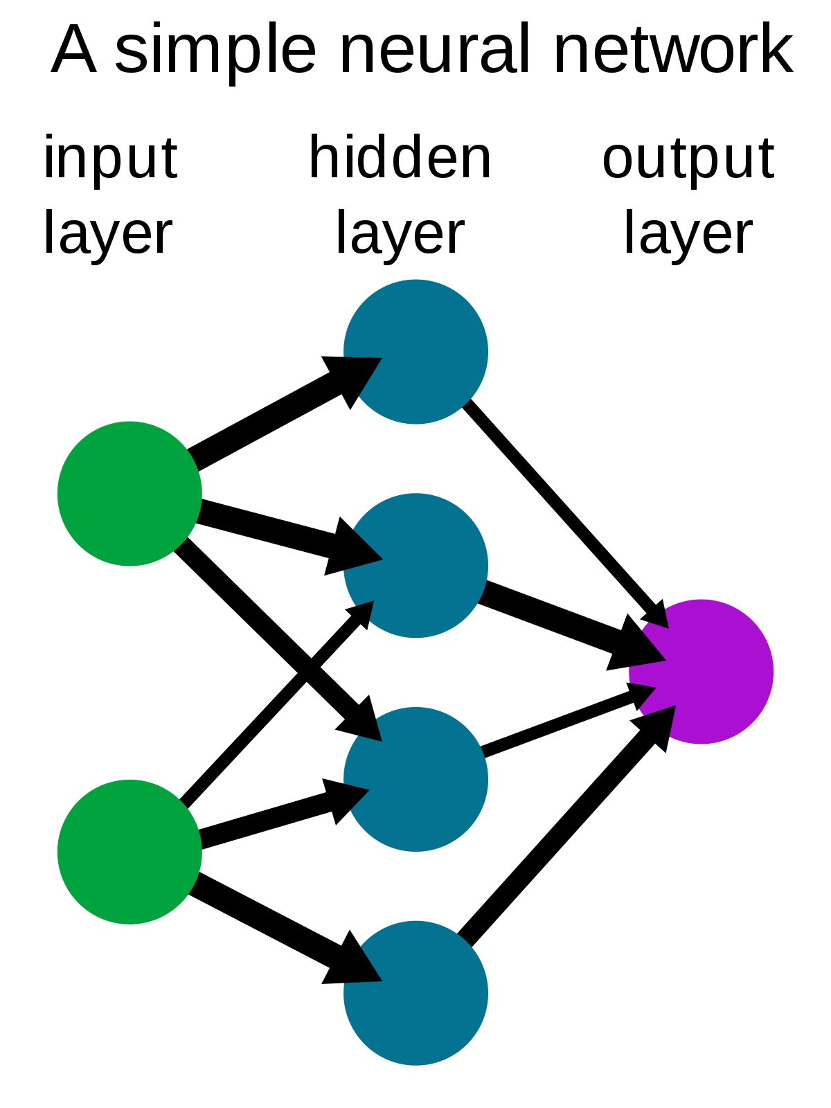
Neural Networks
Neural networks are mathematical models inspired by the human brain.
Feedforward neural networks consist of input, hidden, and output layers.
Recursive neural networks have feedback connections, allowing them to capture dynamic behavior.
Neural networks function as function approximators and can learn from labeled instances.

Slide 15
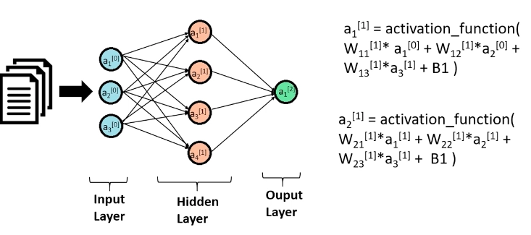
Forward propagation
Forward propagation is the process of passing input data through a neural network.
Input data is passed through each layer of the network.
Neurons in each layer compute a weighted sum of their inputs and apply an activation function.
Activations from one layer become inputs for the next layer.
This process continues until the final output is computed.
The final output represents the network's prediction or computed values.
Forward propagation allows the network to process data and make predictions for tasks like classification or regression.

Slide 16
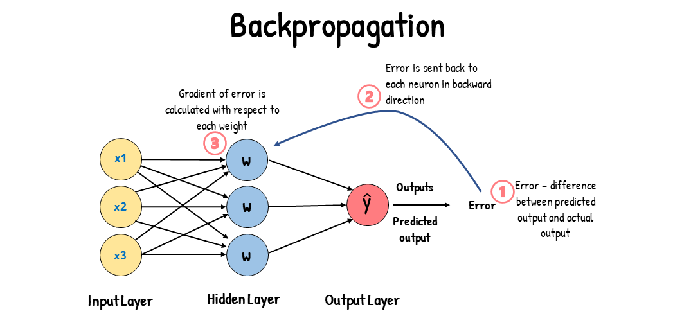
Backpropagation
Backpropagation is used to train neural networks.
It calculates gradients by propagating error from the output to the input layer.
Gradients are computed for weights and biases using the chain rule.
The network's weights and biases are updated using an optimization algorithm (e.g., gradient descent).
This process iterates until the network converges or reaches the desired performance.
In summary, backpropagation enables neural networks to learn from errors and adjust their parameters to improve their performance.

Slide 17
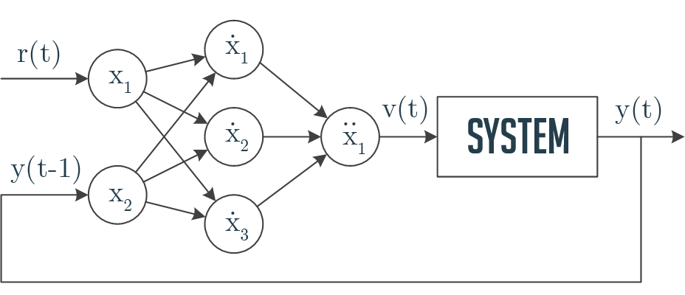
PID Neural Network Controller
Controller based on a neural network with 2-3-1 structure

Slide 18
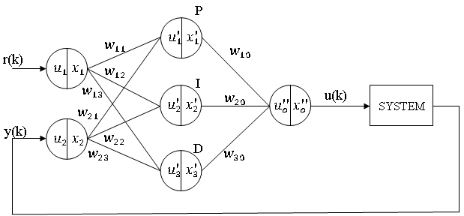
PID Neural Network (PIDNN)
PIDNN is a specialized neural network architecture for controlling actions.
It includes three types of neurons: P-neuron for proportional action, I-neuron for integral action, and D-neuron for derivative action.
The PIDNN architecture enables combining the strengths of neural networks and PID controllers.

Slide 19
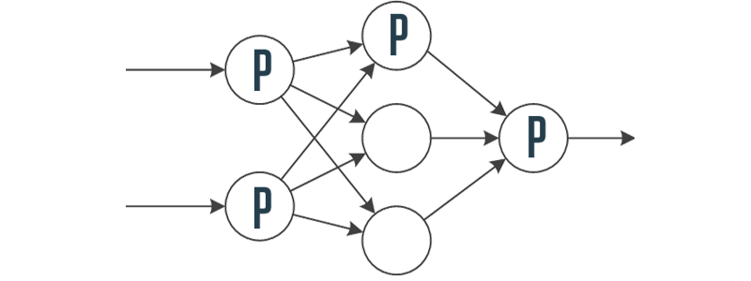
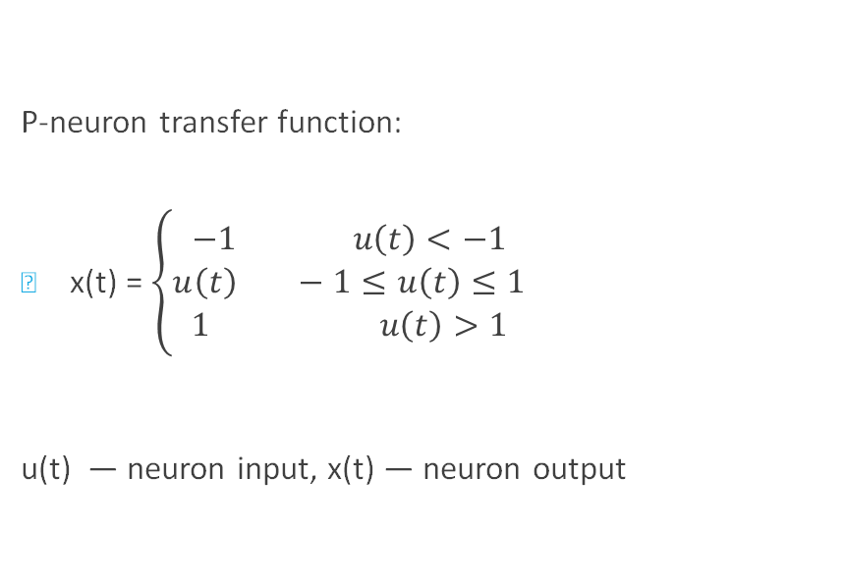
P-neuron
P-neuron transfer function:
x(t) =$\left\{\begin{aligned}−1 u\left(t\right)<−1 \\ u\left(t\right) −1≤u\left(t\right)≤1 \\ 1 u\left(t\right)>1\end{aligned}\right.$
u(t) — neuron input, x(t) — neuron output

Slide 20
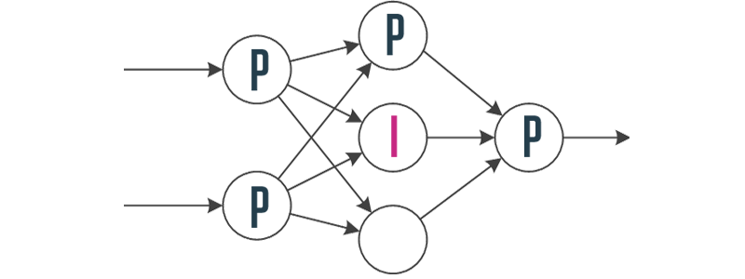
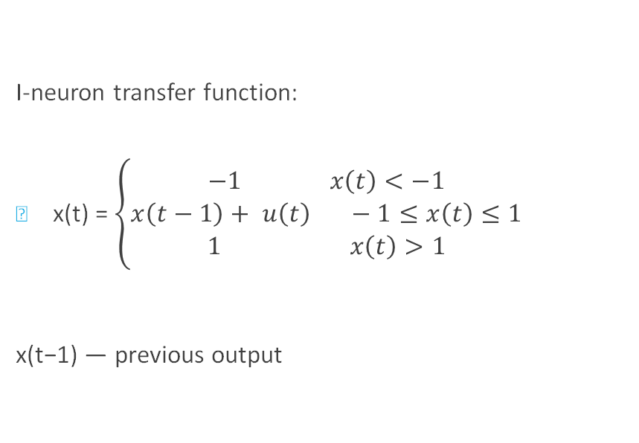
I-neuron
I-neuron transfer function:
x(t) =$\left\{\begin{aligned}−1 x\left(t\right)<−1 \\ x\left(t−1\right)+ u\left(t\right) −1≤x\left(t\right)≤1 \\ 1 x\left(t\right)>1\end{aligned}\right.$
x(t−1) — previous output

Slide 21
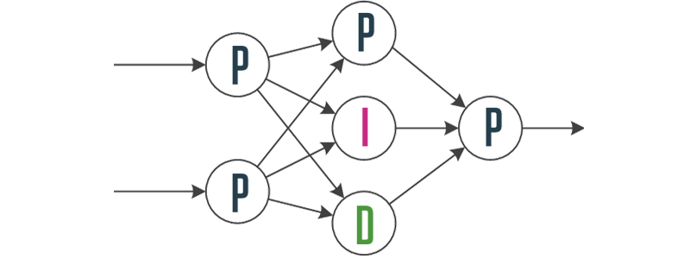
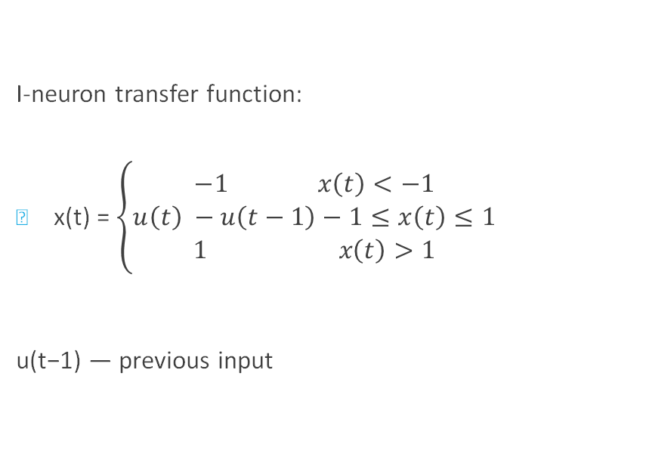
D-neuron
I-neuron transfer function:
x(t) =$\left\{\begin{aligned}−1 x\left(t\right)<−1 \\ u\left(t\right) −u\left(t−1\right)−1≤x\left(t\right)≤1 \\ 1 x\left(t\right)>1\end{aligned}\right.$
u(t−1) — previous input

Slide 22
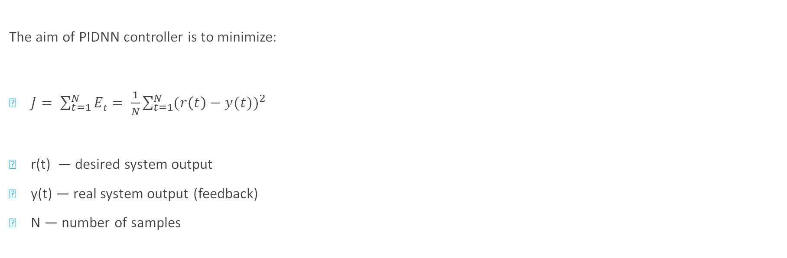
Learning Process
The aim of PIDNN controller is to minimize:
$J= \sum_{t=1}^{N}{Et}= \frac{1}{N}\sum_{t=1}^{N}{{(r\left(t\right)−y(t))}^{2}}$
r(t) — desired system output
y(t) — real system output (feedback)
N — number of samples

Slide 23
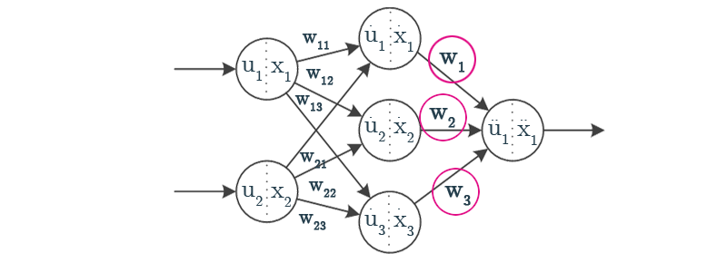
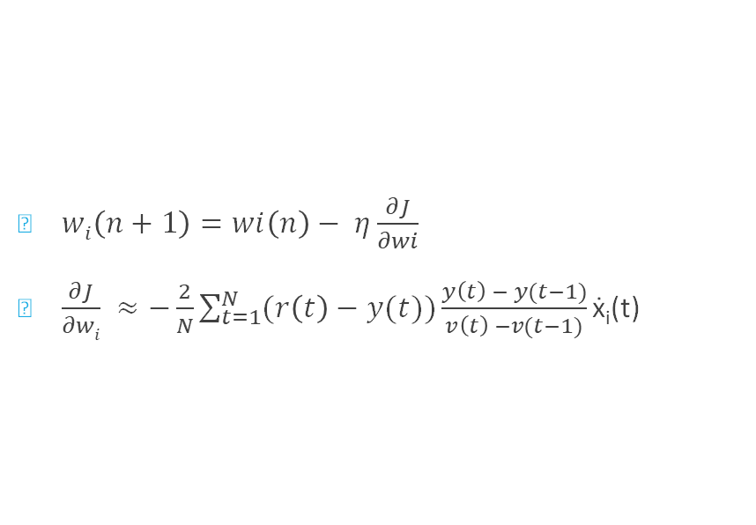
Error Propagation
$wi\left(n+1\right)=wi\left(n\right)− η\frac{∂J}{∂wi}$
$\frac{∂J}{∂wi} ≈−\frac{2}{N}\sum_{t=1}^{N}{(r\left(t\right)−y(t))\frac{y\left(t\right) − y(t−1)}{v\left(t\right) −v(t−1)}\text{ẋ}\text{i}\text{(}\text{t}\text{) }}$

Slide 24
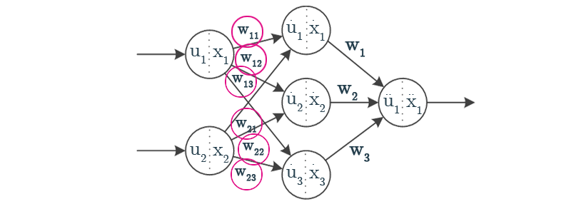
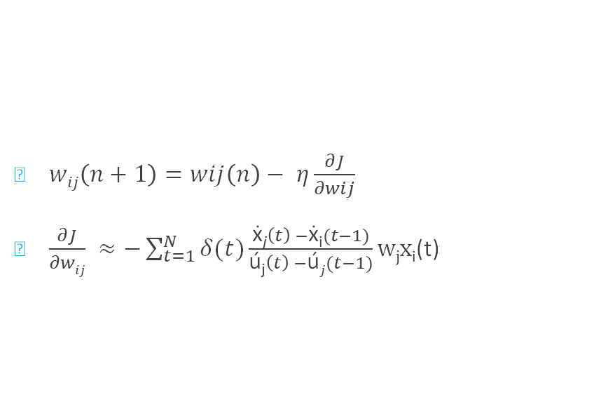
Error Propagation
$wij\left(n+1\right)=wij\left(n\right)− η\frac{∂J}{∂wij}$
$\frac{∂J}{∂wij} ≈−\sum_{t=1}^{N}{δ(t)\frac{\text{ẋ}\text{j}\left(t\right) −\text{ẋ}\text{i}(t−1)}{\text{ú}\text{j}\left(t\right) −\text{ú}j(t−1)}\text{w}\text{j}\text{x}\text{i}\text{(}\text{t}\text{) }}$

Slide 25
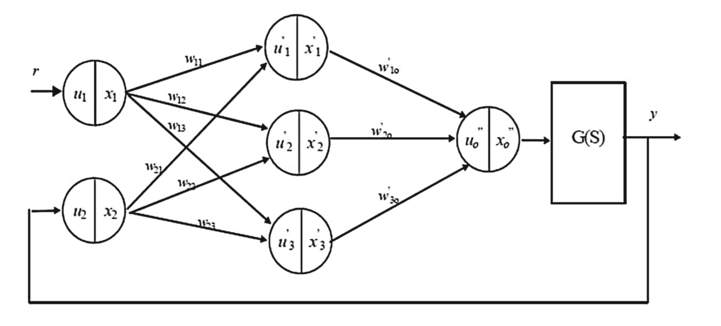
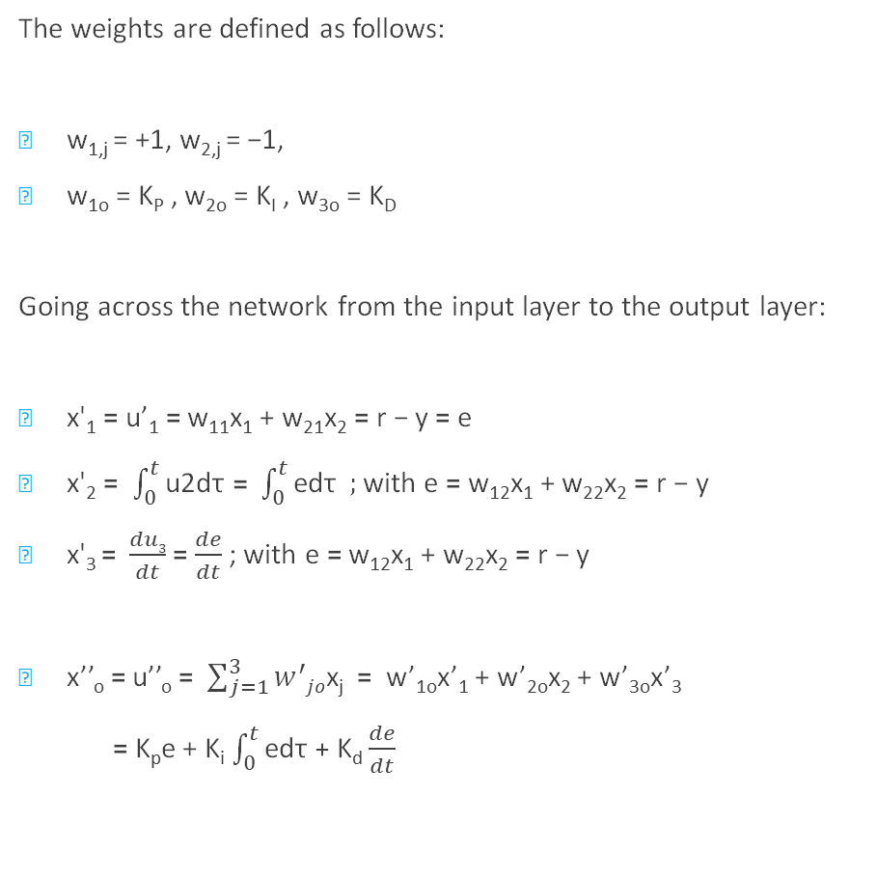
The weights are defined as follows:
w_{1,j} = +1, w_{2,j} = −1,
w_{1o} = K_{P} , w_{2o} = K_{I} , w_{3o} = K_{D}
Going across the network from the input layer to the output layer:
x'₁ = u’₁ = w₁₁x₁ + w₂₁x₂ = r − y = e
x'₂ = $\int_{0}^{t}{\text{u}\text{2}\text{d}\text{τ}}$ = $\int_{0}^{t}{\text{ed}\text{τ}} ;$ with e = w₁₂x₁ + w₂₂x₂ = r − y
x'₃ = $\frac{du3}{dt}$ = $\frac{de}{dt}$ ; with e = w₁₂x₁ + w₂₂x₂ = r − y
x’’_{o} = u’’_{o} = $\sum_{j=1}^{3}{w^{′}jo}$x_{j} = w’_{1o}x’₁ + w’_{2o}x₂ + w’_{3o}x’₃
= K_{p}e + K_{i} $\int_{0}^{t}{\text{ed}\text{τ}}$ + K_{d} $\frac{de}{dt}$

Slide 26
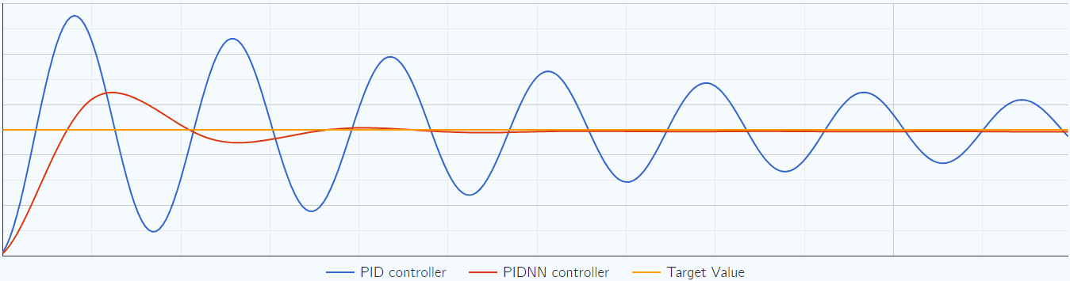
Controller Performance

Slide 27
Experimental Setting and Results
The experiment involved a non-minimum phase system as the plant model.
Simulink, a simulation tool, was used to simulate the PIDNN controller.
The error back-propagation algorithm was employed for weight updates during training.
We get desired K_{p}, K_{i}, K_{d}.

Slide 28
Conclusion
Neural networks show promise in modeling and tuning PID controllers.
Recursive neural networks can capture the dynamic nature of PID controllers.

Slide 29

Thanks! Got any Question?

